Slide 1
Delivering More Than A Meal: Impact of Home-Delivered Meal Service Models on Clients’ Health
Kali S. Thomas, PhD
Assistant Professor (Research), Department of Health Services, Policy and Practice, Brown University
and
Research Health Scientist, Providence VAMC
March 23, 2016

Slide 2
Background
Much evidence suggests benefits of home-delivered meals (HDMs)
Research needed
  Quantify improvement in quality of life
  Determine effectiveness of the daily “check in” and social contact
Notes:
Previous work I conducted with my colleague Vince Mor
Additional beneftis provided by the daily safty check and soicalization
In addition to my work, strong evidence that HDM has a positive impact on the nutritional well-being of older persons. Participants exhibit improvements in dietary patterns and decreases in food insecurity
We believe that it improves the quality of life but we need to show
And we needed to know if the hypothesized effect of HDM on community tenure was indeed due to the daily check in.

Slide 3
Motivation for Study
Funding cuts and increased costs = fewer seniors served, fewer meals delivered, increase in waiting lists
New lower cost model of frozen, once-weekly meal delivery
Notes:
In early 2013, sequestration began
MOW wanted to demonstrate the impact of their organization’s service and mission.
In addition to fighting the effects of sequestration, that programs across the country were struggling because of federal, state and local funding cuts and increased transportation and food costs. These compounding factors had resulted in hundreds of thousands of fewer seniors served, millions of fewer meals delivered, and a new, discouraging effect: establishment and dramatic increases in waiting lists for the program.
Meals on Wheels programs were also facing, for the first time, a new competitor in the market who delivered a more affordbale model of delivering frozen meals to clients once a week. In this frozen delivery model, drivers provide the full week’s meals in one delivery per week. Thereby limiting the frequency of the interaction between clients and drivers which many believe as being one, if not THE most beneficial aspect of the program.
Meals on Wheels Needed research findings that they could use in advocacy for increased funding that would describe this new population on waiting lists and the impact of home-delivered meals on clients outcomes. But they also needed research to document whether or not their traditional model of five meals a day had superior outcomes to meals delivered with less frequent contact.

Slide 4

“More Than A Meal” Study
Pilot funded by AARP Foundation
Study Aims
  Aim 1. Characterize seniors on waiting lists for HDM
  Aim 2. Evaluate the impact of HDMs
  Aim 3. Evaluate the comparative effectiveness of meal delivery method
Secondary Goals
  Practicality of conducting RCT with this population
  Refine methods for larger scale evaluation

Slide 5
Design
Three-arm randomized controlled trial
  Frozen, once-weekly delivered meals
  Daily-delivered meals
  Remain on waiting list
8 sites
626 participants
Baseline survey (in person) and 15-week follow-up (via telephone)
Notes:
One thing that has made evaluation of the HDM program difficult, has been an adequate control group on which to base comparisons of outcomes. It is unethical to withhold meals from individuals who are need of assistance.
Taking advantage of the waiting lists as we had an aequate control group of individuals who self-identfy as needing home delviered meals but are unable to be served.
Surveys covered a number of domains, including health, healthcare utilization, quality of life, socialization, and demographic characterstics. We included validated and cognitively tested questions from other instruments like the National Health and Aging Trends Study on which we could base our comparisons.

Slide 6
Initial Interview
Programs compiled waiting lists
Participants were contacted to schedule in-person interviews
Consent participants and complete in-person interviews (N=626)
Meal delivery began and continued 15 weeks
Programs randomly identified participants who would receive either daily delivered meals (n=213), frozen meals delivered once weekly (n=202), or would remain on the waiting list (n=210)
Notes:
either daily-delivered meals (n=213), frozen meals delivered once weekly (n=202), or to remain on the waiting list (n=210).

Slide 7
Follow-Up Interview
Data entered and sent to Meals on Wheels America
Conducted follow-up interview over telephone
(n=459; 154 in control group, 174 in daily-delivery group, and 131 in frozen, once-weekly delivery group)
Participants contacted to schedule follow-up interview
Notes:
A final sample of 154 remained in the control group, 174 in the daily-delivery group, and 131 in the frozen, once-weekly delivery group.

Slide 8
Data Analysis
Data verified and cleaned by study personnel
Baseline and outcomes analyses
Tested for balance between groups at baseline
Examined rates of attrition and loss to follow-up
Notes:
At least 10%
Ensure groups were similar

Slide 9
Demographic Characteristics
Marital Status
 | Married | 23%
 | Widowed | 45%
Age
 | <65 | 15%
 | Age 85+ | 25%
Education
 | Less than high school | 28%
 | High school diploma or GED | 40%
 | Some college or higher | 32%
Race and Ethnicity
 | White | 60%
 | Black | 33%
 | Hispanic or Latino | 12%
Medicaid |  | 31%
Notes:
Majority were white female, widowed, had earned a high school degree with an average age of 76.

Slide 10
Help with Personal Care Needs
Notes:
58% of participants report needing the help of another person with personal care needs because of a physical, mental, or emotional condition.
When asked about the future, only 63% of participants said that they have friends or relatives who would be willing and able to help them over a long period of time if they needed help with basic personal care activities.

Slide 11
Social Support
How often do you have contact with friends or family?
Is there a family member, friend, or neighbor that you feel you can call on for help if you need it?
Notes:
When asked about social support, only 59% of partinat reporting having contact with friends or family. An additional 24% reporting having contact with friends or family once or twice a week, 10% have contact once or twice a month, and 8% report having contact less than once a month.
13% have no one to call on for help.
Suggests that a somewhat alarming proportion of older adults on waiting lists for MOW have limited if any social support.

Slide 12
Comparing Participants to the Population of Seniors Nationally
Nationally Representative Survey
  2013 National Health and Aging Trends Survey (NHATS)
      Self-Rated Health
      Anxiety & Depression
      Fear of Falling
      Difficulty Shopping and Cooking
      Observations Inside and Outside the Home
Analyses
  Chi-square to test differences between groups
Ref. Thomas, K.S., Smego, R., Akobundu, U., and Dosa, D. (2015). Journal of Applied Gerontology

Slide 13
Participants Have Worse Self-Rated Health than Seniors Nationally
Groups significantly different at the p<.001 level
Ref. Thomas, K.S., Smego, R., Akobundu, U., and Dosa, D. (2015). Journal of Applied Gerontology
Notes:
71% of MTAM sample rated their self rated health as fair to poor compared to 26% of seniors, nationally

Slide 14
Participants More Likely to Have Depression and Anxiety than Seniors Nationally
Depression measured using PHQ-2 and Anxiety measured using the GAD-2;
Groups significantly different at the p<0.001 level.
Ref. Thomas, K.S., Smego, R., Akobundu, U., and Dosa, D. (2015). Journal of Applied Gerontology
Notes:
Twice as likely to screen positive for depression and anxiety

Slide 15
Participants More Likely to Have Fallen and Have the Fear of Falling Limit Activities than Seniors Nationally
MTAM Seniors |  | Seniors Nationally
27% | Fallen | 10%
56% | Worried about falling | 27%
79% | Fear limited activities | 42%
Groups significantly different at the p<0.001 level
Ref. Thomas, K.S., Smego, R., Akobundu, U., and Dosa, D. (2015). Journal of Applied Gerontology
Notes:
Q: “In the last month, have you fallen down?”
Q: “In the last month, did you worry about falling down?”
Q: “In the last month, did this worry ever limit your activities?”
Significantly more likely to have fallen in the past month
Fell on average 2.2 times ranging from 2-20
Higher proporption reported being fearful of falling and having this fear limit their activities.

Slide 16
Participants More Likely to Need Help Shopping for Groceries and Preparing Food than Seniors Nationally
MTAM Seniors |  | Seniors Nationally
87% | Shop for groceries | 23%
69% | Prepare or heat up food | 20%
Groups significantly different at the p<0.001 level
Notes:
Also, of those who need help shopping with groceries, 12% do not have someone to help them.
Of those who need help preparing or heating up food, 25% do not have someone to help.
MTAM: Q: “Are there times when you are not physically able to shop for groceries?”
Q: “Are there times when you are not physically able to prepare or heat up your food?”
NHATS: Respondents who replied (a) they had assistance for health or functioning reasons or (b) they performed the activity themselves with difficulty were considered to have need for assistance.

Slide 17
MTAM Participants Have More Exterior Hazards Than Seniors Nationally
Q: “Standing in front of the respondent's home/building, did it have…”
Groups significantly different at the p<0.001 level.
Notes:
Two times higher likelihood of having exterior hazards

Slide 18
MTAM Participants Have More Hazards Inside the Home Than Seniors Nationally
Q: “Inside the respondent's home/apartment/unit, did you observe…”
Groups significant different at the p<0.001 level
Notes:
Greatest differences inside the home… the most troubling given that these folks are homebound.
3-5 times more likely to have interior hazards.

Slide 19
Aim 1 Conclusions
American older adults on Meals on Wheels waiting lists need a variety of supports
Need additional help beyond meals
  Important to assess these needs
  Referral to other services
  Opportunities for collaboration
Notes:
Assess needs: they can answer these questions!
Referral to other services: without asking, we’ll never know.
Opportunities: grant writing, collaboration, innovative program partnerships, get these seniors SOME help.

Slide 20
Study Aims 2 & 3
Evaluate the impact of home-delivered meals
Evaluate the comparative effectiveness of meal delivery method
Primary Outcomes of Interest
  Mental health, self-rated health, social isolation/loneliness, feelings of security and safety
Secondary Outcomes of Interest
  Hospitalization, falls, satisfaction
Notes:
In aims 2 and 3 we were interested in knowing if improvement and rates of outcomes differed between the three groups.
While we looked at a variety of domains, today I will present the outcomes results that I think will be of most interst to this group.
Specifiically, improment in mental health, self-rated health, and loneliness; and the rates of hospitalization and falls.

Slide 21
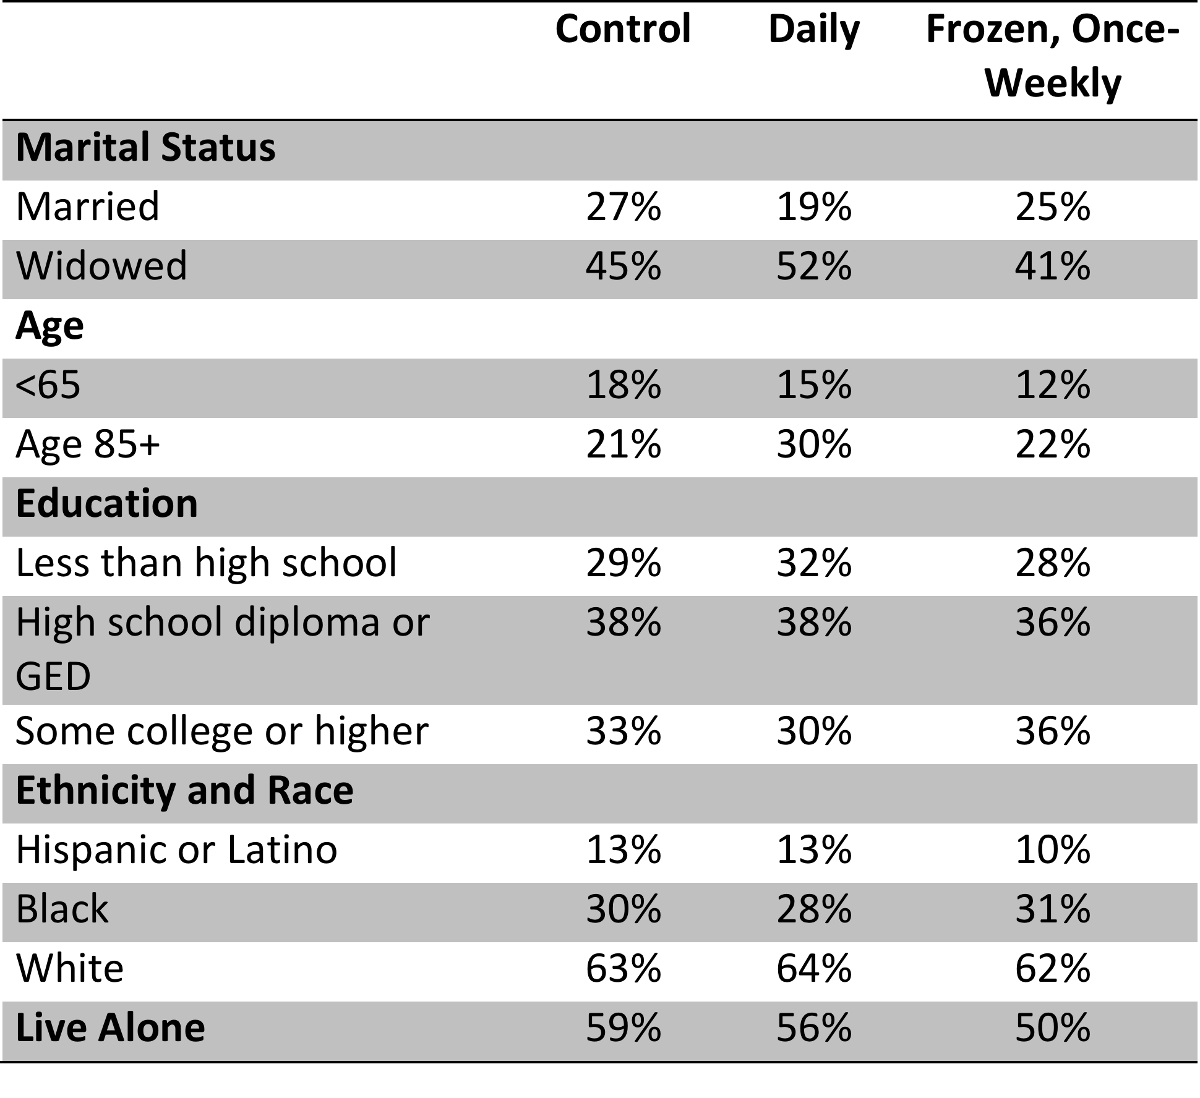
Demographic Characteristics
Note. N=626. Measures did not differ significantly by group, or by site
Notes:
No significant differences between groups or across sites.
Majority were white female, widowed, had earned a high school degree with an average age of 76.

Slide 22
Retention and Reasons for Attrition
Average retention rate across all sites was 74% (n=459)
Varied from 68% to 87%
No differences between groups, within site
Notes:
Average retention rate across all sites was 74% with 459 pariticpants submitting outcomes data.
This rate varied from 68-87% and again we found no differences within group or within site.
The primary reasons for attrition were no longer wanting or needing meals, moving out of the service area, or could not be contacted at follow-up with no differences between groups, between sites, or between groups within sites.

Slide 23
Improvement in Mental & Self-Rated Health
 | n | Control | Daily | Weekly, Frozen
Anxiety | 99 | 44% | 54% | 57%
Depression | 115 | 51% | 61% | 71%
Self-Rated Health | 449 | 23% | 29%⁺ | 24%⁺
Note: Depression measured using PHQ-2 and anxiety measured using the GAD-2;
⁺ = p<.10
Notes:
We calculated the proportion of residents who formerly exhibited symptoms of anxiety or depression but no longer met those criteria in the follow-up survey.
We found that there were no statistically significant differences between the groups in terms of improemvent in mental health.
However, we did find marginally significant differences between the groups receiving meals in terms of improvement in self0rated health, with the group receiving daily-delivered meals having the greatest improvement.

Slide 24
Decreasing Worry about Staying Home
**
+
ns
ns
+ = p<.10; ** = p<.01; ns = not significant

Slide 25
Improvement in Loneliness^
**
ns
ns
ns
^Adjusted analyses published: Thomas, Akobundu, Dosa (2015) J Geron Soc Scie
** = p<.01; ns = not significant
Notes:
We used the three items that comprise the UCLA loneliness scale to create a loneliness score for individuals at baseline and loneliness.
We did not find a statistically signifcant difference among full sample
When we stratified by the sample to examine improvement in loneliness among individuals that live alone, we found greater rates of improvement among the groups receiving meals.

Slide 26
Self-Reported Improvement in Loneliness^
*
^Adjusted analyses published: Thomas, Akobundu, Dosa (2015) J Geron Soc Scie
* = p<.05
Notes:
But when asked if “home-delivered meals helped participants feel less lonely” the group receiving daily delivered meals was signifaicntly more likely to report that they did.
The improvemnet in loneliness finding was an important finding for a number of reasons: first, loneliness and senior isolation is an agenda for AARP Foundation and therefore these results helped in their campaigns.
In addition, there is a vast body of literature which shows that loneliness is not only a quality of life issue, but it is a predictor of physical and mental health outcomes, disease, and function. Therefore, this finding has important implications for health systems and health care payors.

Slide 27
Feelings of Safety
*
* = p<.05
Notes:
The group receiving daily delivered meals were also signifciantly more likely to indicate that HDM helped them feel safe.
When probed about why the meals help them to feel safe, the qualitative results suggest the reasons differed between the two groups. Among the group receiving daily delivered meals, the majority (49%) reported some aspect of the delivery (i.e., social contact or being checked in on) contributing to feelings of safety, compared to respondents receiving frozen meals who were more likely to reference staying out of the kitchen, or having a dependable, healthy meal.

Slide 28
Hospitalization and Falls^
*
+
ns
+ = p<.10; * = p<.05; ns = not significant
Notes:
Using our sample of individuals with data at both time points, we found that 14% of individuals who received meals were hospitalized during the study period compared to 20% of individuals in the control group. We were challenged by the sample size to detect a statistcally significant difference, a difference between 14% and 20% equates to a significant cost.

Slide 29
Satisfaction
99% of participants in both groups would recommend program to others
Reasons for recommendation vary
  Daily: “Help” or “Driver”
  Frozen, once-weekly: “Meal”
Notes:
“Would you recommend this program to others?”
Majoirty of daily delivered meals referenced something about the help that the meals provided in their life (convenience, peace of mind) or the driver (friendly visit, purpose in day, checkin in) while the 73% of those receiving frozen meals placed emphasis on the meal – Cost, dependable, healthy, tasty.

Slide 30
Conclusions: Aims 2 and 3
Home-delivered meals have many benefits in addition to improved nutrition
  Significant improvements in security and loneliness among individuals living alone
  Marginally significant difference in hospitalization rate
  Significant difference in rate of falls
Benefits from daily-delivered meals greater than once-weekly delivered, frozen meals
  Significant improvements in loneliness, self-rated health, feelings of safety
  Significant difference in rate of falls
Notes:
Large and emerging body of literature linking loneliness to health outcomes.
Signfiicant reduction in falls among those at risk of falling.
For some outcomes, the benefits of the contact afforded by daily-delivered meals exceed those of once-weekly delivered, frozen meals

Slide 31
Limitations
Sample size (power)
Once-weekly delivery in this study by Meals on Wheels programs were not comparable to the competitor model that drop-ships frozen meals
Randomization and data collection by sites
Findings are based on self-report
Notes:
While it was a rather large grant, the bulk of the funding went to paying for 15 weeks of meals to bring the two treatment groups off of the waiting list.
Therefore, we were somewhat limited in the size of the population we could enroll in the study. This may have affected our power to detect a significant effect on some outcomes that were rare like improvement in mental health or hospitaliation. IT also limited our ability to present analyses beyond basic descriptive results.
Another limitation is that when we were coding the open-ended qualitative information that I didn’t report here, many participants receiving frozen once-weekly delivered meals reported some aspect of looking forward to seeing their driver, or visiting with their driver, suggesting that we may not have been able to replicate the model on which we were trying to base our comparisons. And if anything, our results may have been somewhat attenuated.
Another limitation is that we had the programs randomize the participants and it was therefore not blinded. However, we stressed the importance in the training webinars of making the allocation be truly random and the groups were balanced at baseline on the observable characteristics so we believe that the randomization worked.
And as is common with any evaluation study that collects information via self-report, the findings may be subject to social-desirability bias.
However, despite these limitations we had a positive pilot and results that have had great impact on the aging and nutrtiion networks.

Slide 32
More Than A Meal: Phase 2 - Ongoing
Funded by Gary and Mary West Foundation (GMWF)
Linking client records to Medicare Claims to examine differences in healthcare utilization and costs
  Hospitalization (all-cause and preventable)
  Emergency Department visits
  Nursing home placement
Notes:
We are currently funded for a project with Meals on Wheels America by West Foundation to address some of the limitations we noted from the pilot RCT. Specifically, the issue of sample size and self-report. In this 2nd phase, we are linking client records to Medicare claims to examine differences in healthcare utilization and costs. Specifically, hospitalization, ed visits, and nursing home placement.

Slide 33
Design
15 programs across the country
Client rosters 2010-2013 (38,000+ clients)
Compare outcomes between daily and limited meal delivery
Compare outcomes between meal recipients and propensity-matched controls
Notes:
We are working with 15 projects across the country who have shared with us their list of clients served between 2010 and 2013. We are using deterministic and probablisitic matching to link clients records with their respective Medicare claims data.
With these data, we will compare the outcomes of clients receiving daily delivered meals to clients receiving limited, once-weekly delivered meals.
We are also investigating whether the otucomes differe between meal recipients and propensity score matched controls.
propensity score matching (including matching with/without replacement, greedy/optimal matching, 1-to-1/many-to-1, or nearest neighbor/nearest neighbor matching within a specified caliper distance), propensity score weighting coarsened exact matching will be considered. These decisions will be made in conjunction Roee and will be guided by our examination of the data and the degree to which the balance can be achieved.
The propensity score model will be a multivariable, non-parsimonious logistic regression model with the dependent variable being whether or not the older adult receives meals. We will select criteria to include, like age and living in the same ZIP code.
Follow the steps by Rubin 1) to determine a priori which covariates are likely to be key determinants of receiving cash benefits; 2) I will examine a broad range of covariate specifications (including non-linear covariates, and two/three-way interaction terms) to determine which specification achieves the best balance between groups, 3) I will apply lenient criteria for covariate inclusion,⁷⁴ and 4) I will conduct extensive sensitivity analyses. When completed, each Veteran will have a propensity score that I will then be able to use to create balance between the “treatment” and “control” groups.
Cost and outcomes – examine zeros NLMIXED procedure, incorporating zero-inflation and overdispersion.

Slide 34
Results
To Be Continued…

Slide 35
Acknowledgements
Co-Investigators
David Dosa, MD, MPH
Pedro Gozalo, PhD
Roee Gutman, PhD
Vince Mor, PhD
Students
Aderonke Ilegbusi
Mingyang Shan
Raul Smego
Jinru Tao
Project Staff
Rajesh Makenini
Cindy Williams
Funders
AARP Foundation
Gary and Mary West Foundation
Community Partners
Meals on Wheels America
Meals on Wheels America Members
  Aging, Disability & Transit Services of Rockingham County, Reidsville, NC
  Athens Community Council on Aging, Athens, GA
  Broward Meals on Wheels, Plantation, FL
  Community Meals, Houston, TX
  Interfaith Ministries for Greater Houston, Houston, TX
  Meals on Wheels of Ocean County, Lakewood, NJ
  Meals on Wheels of Rhode Island, Providence, RI
  Putnam County Senior Citizens Center, Unionville, MD
  Meals on Wheels of Tarrant County , Fort Worth, TX
  The Heritage Area Agency on Aging, Cedar Rapids, IA
  VNA Meals on Wheels, Dallas, TX
  Open Hand, Atlanta, GA
  Guernsey County Senior Citizens Center, Inc. Cambridge, OH
  Western South Dakota Senior Services, Inc. Rapid City, SD
  Meals on Wheels of Lancaster, Inc. Lancaster, PA
  Chapel Hill-Carrboro Meals on Wheels, Chapel Hill, NC
  Meals on Wheels of Greater San Diego, Inc., San Diego, CA
  Riversiide MOW, Riverside, CA
  Doc Services, Inc., Miami, OK
  Meals on Wheels of Shawnee and Jefferson Counties, Inc. Topeka, KS
Notes:
I want to acknowledge the Partners who were part of the collective We I referenced in the last two studies

Slide 36
Thank you!
Kali_Thomas@Brown.edu

Slide 37
Waiting lists: practice and policy implications
Uche Akobundu, PhD, RD
March 23, 2016

Slide 38
Waiting lists: policy & practice implications
Some Frequently Asked Questions
What is a waiting list?
Why are there waiting lists?
Who is placed on a waiting list?
How many programs have waiting lists?

Slide 39
Why are there waiting lists?
Thousands of seniors are currently waiting to receive Meals on Wheels nationwide.
Declining federal funding through the Older Americans Act, cuts in state and local grants, stagnant private funding and rising food, transportation and operational costs all have led to a growing gap between those served and those in need.
With the senior population set to double by 2050, Meals on Wheels America felt is was important to act now to shine a light on this issue.

Slide 40
Waiting lists: policy & practice implications
Practice Implications
Challenges:
  Inability to provide timely, preventive nutrition services to those in need
  Waiting list management – assessment, prioritization
Opportunities:
  Advocacy – #SeniorsCantWait Campaign
  Research – MTAM & Randomized Controlled Trial design
  Service Expansion – Stakeholder & payor partnerships
  Volunteers & Community – Opportunities for engagement
Notes:
Service Expansion – Betsy Cox VNA Houston and ADTS Rockingham Co. – MTAM 1 participants leveraged MTAM study to engage local healthcare systems and funding partners in pilot programs to expand services to those on the waiting list applying rigorous outcomes evaluation assessment tool developed for the study.
Programs like the Montgomery Area Council on Aging implements a Frozen Meals program – leveraging partnerships within the community to source and store frozen meals that are offered to individuals waiting for daily hot, home-delivered meal services to commence.

Slide 41
Advocacy: #Seniorscantwait
November 2015, Meals on Wheels America launched the #SeniorsCantWait campaign
We heard from Members in 32 states
Members participating in this Campaign received a #SeniorsCantWait Toolkit comprised of:
  Two customized images – for Facebook and Twitter
  Template Press Release
  Elected Officials Social Media Contact Information
  Social Media Best Practices
  Template Social Media Tweets and Posts

Slide 42
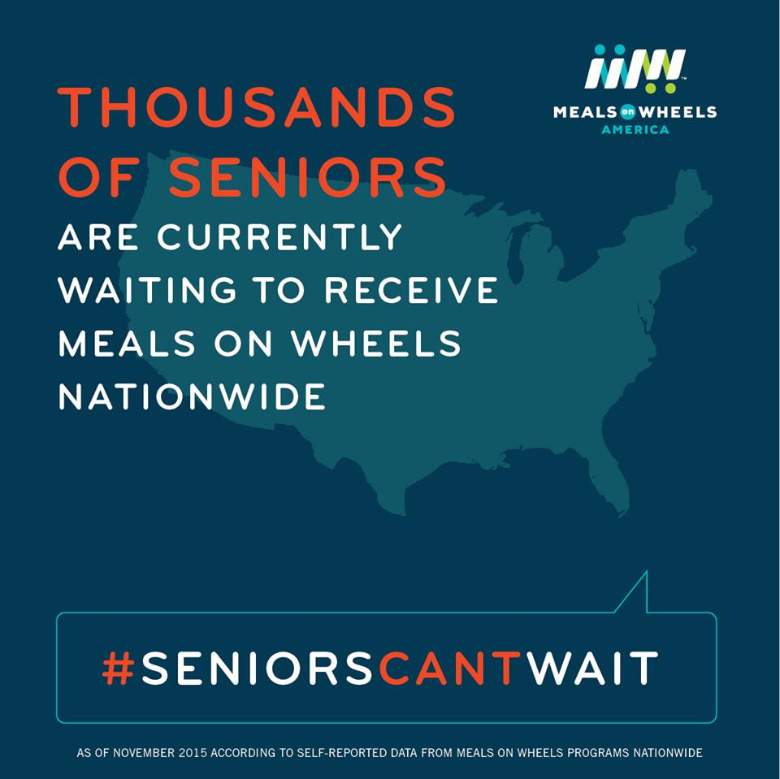
#Seniorscantwait Campaign

Slide 43
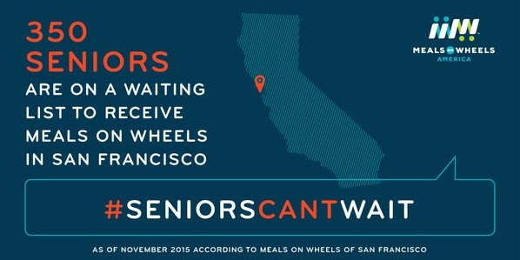
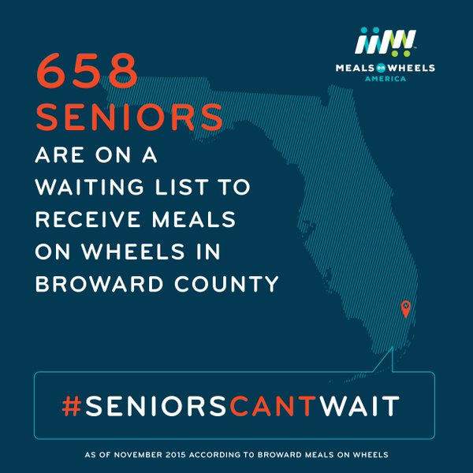

#Seniorscantwait Campaign: Social images

Slide 44

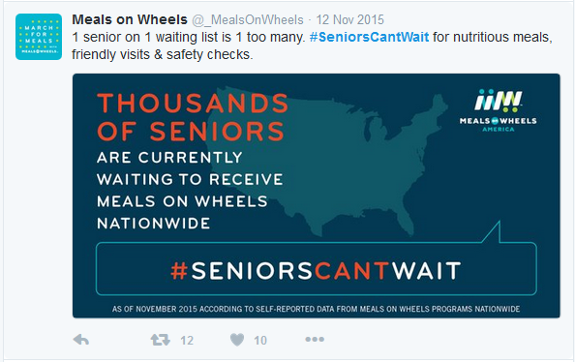
#Seniorscantwait Campaign: Sample tweets

Slide 45
#Seniorscantwait Campaign: REsults
We heard from Members in 32 states
100 Members reported having more than 20,000 seniors on waiting lists across the country
  Meals on Wheels America has 1,100 Members
  Findings reflect a small subset - likely undercounts the severity, but illustrates a real problem
>50% of Members said their program's waiting list is bigger than it was a year ago

Slide 46

Learn more…

Slide 47

Service expansion: ADTS Rockingham co.
Help Advocate for People We Serve
  Raise money
  Raise awareness
Change the Conversation
  Capture meaningful data
  Shift from outputs to outcomes

Slide 48
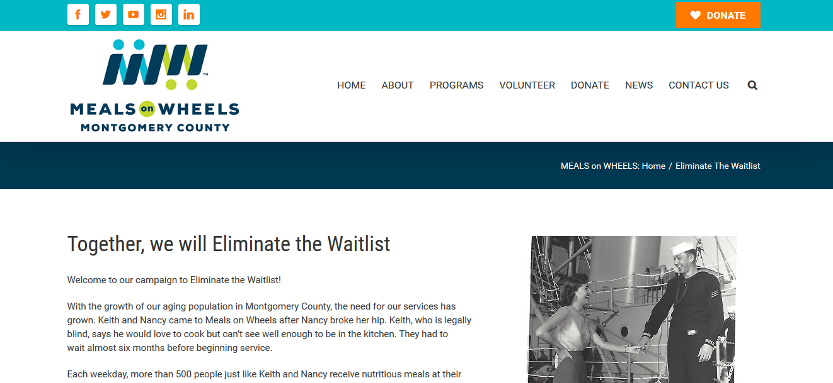
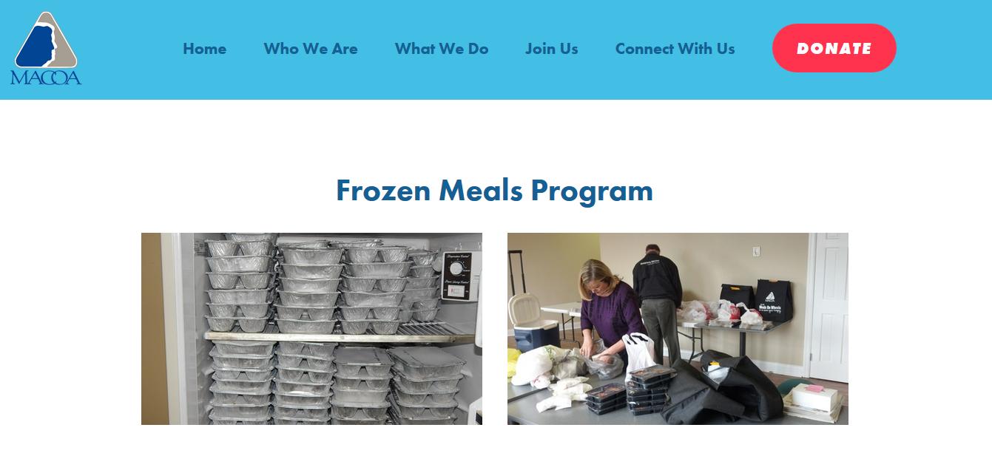
Volunteer & community engagement

Slide 49
Waiting lists: policy & practice implications
Policy Implications
  Targeting of nutrition services to those in greatest health and social need vs serving all those in need
  Sufficient funding needed to meet growing need
    This week we mark the 44th anniversary of the creation of the Older Americans Act Nutrition Programs & celebrate the advancement of the Older Americans Act through the legislature
    Both strong legislation and robust appropriations are needed to stem the rising need, and provide cost-effective and impactful nutrition services to millions of seniors

Slide 50
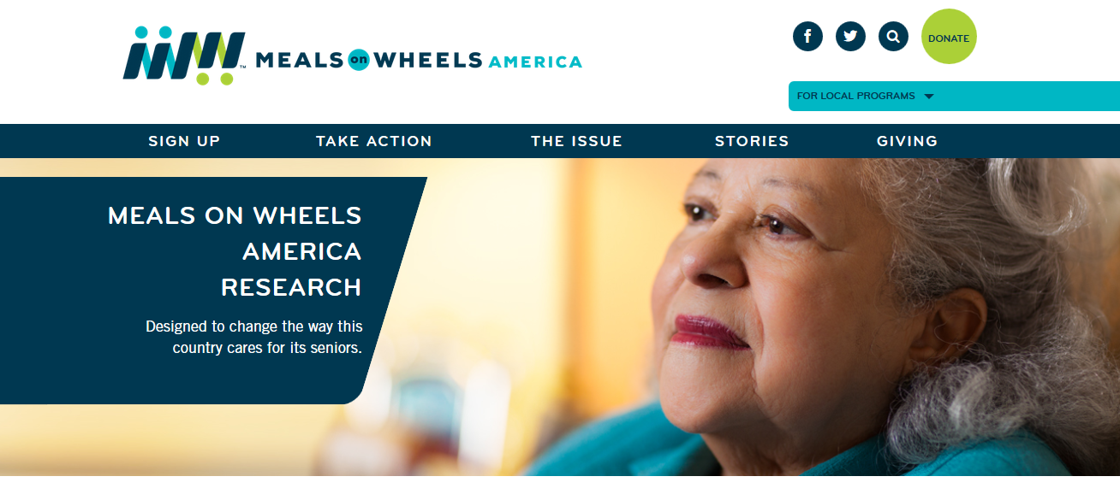
Stay tuned…

Slide 51
Thank you!
Uche Akobundu, phd, rd
uche@mealsonwheelsamerica.org

