Slide 1
Emerging Opportunities for Community Based Nutrition Services in the Developing Healthcare Environment
Linda Netterville, RD, LD
Vice President, Program Development and Impact, Meals on Wheels America
Magda Hageman-Apol
Vice President, Education and Training, Meals on Wheels America
www.nutritionandaging.org

Slide 2
Session Overview
The National Resource Center on Nutrition and Aging
The changing healthcare market
Opportunities for nutrition services
  Changing resources
  The role of nutrition services
Learning from others
  Action Learning Collaborative Initiative “Building the Business Capacity of Senior Nutrition Programs”

Slide 3
National Resource Center on Nutrition and Aging
Funded by the Administration for Community Living/Administration on Aging
Awarded September 2011 to Meals On Wheels America
Funded through September 2017
Notes:
Goals apply to all levels of aging services network: state units on aging, area agencies on aging and local nutrition service providers

Slide 4
The Changing Healthcare Market
Patient Protection and Affordable Care Act of 2010
Triple Aim
  Better care
  Healthier people
  Smarter spending
Notes:
The Patient Protection and Affordable Care Act
Health Reform. Commonly called the Affordable Care Act or ACA
Signed into law by President Obama on March 23, 2010
On June 28, 2012, the Supreme Court rendered a final decision to uphold the law
ACA continues to have sweeping changes to the healthcare delivery system across the country
Understanding the true impact of the changes imposed by ACA requires understanding how the current system evolved and the difference between where our system was an where it is going based on ACA mandates

Slide 5
The Changing Healthcare Market
Better care
Healthier People
Triple Aim
Smarter Spending

Slide 6
The Changing Healthcare Market
Managed Care (MCO) has completely commercialized the delivery of Medicaid services
  HCBS
  Long-Term Services and Supports
Accountable Care Organizations (ACOs)
Hospital/SNF payment reforms
Bundled Payment Initiatives

Slide 7
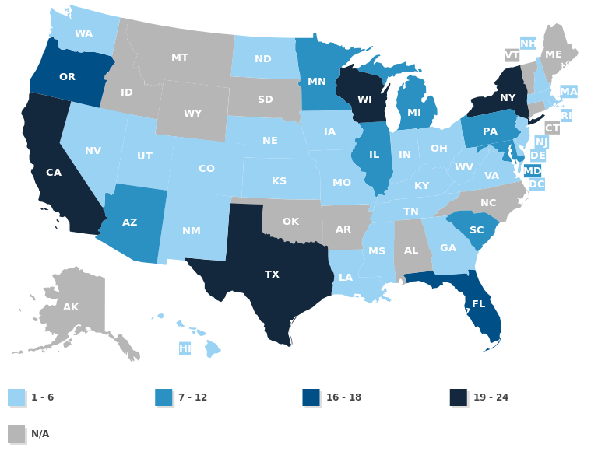
States with MLTSS - 2015
Notes:
Twenty six states have some form of MLTSS.

Slide 8
The Changing Healthcare Market
Services must meet the needs:
    Customer – Payer
    Consumer – Beneficiary (client or patient)
Focused on quality metrics and improved outcomes
Payers assume the risk
Want a clearly defined Return on Investment (ROI)
Opens the door to for-profit entities
Notes:
The new marketplace requires that you meet the needs of the customer and the consumer
Customer – Managed Care Plan
Consumer – Beneficiary receiving services paid for by the Managed Care Plan

Slide 9
What the Healthcare Payer is Seeking
Meet consumer needs
  Choice of meals, special or modified diets, flexibility in
  delivery
  Other services – nutrition counseling, and evidence-
  based programs
Access to the consumer
Coverage for the entire service area (1 contract)
Easy to submit referrals for services
Cost effectiveness
Meet quality metrics
Data provided to show improved outcomes

Slide 10
Changing Resources for Nutrition Programs
Government and Public Funding
Older Americans Act: Title III (C1, C2, NSIP), V, VI
Other Federal
  Social services or community service block grants
State Funding - Variance by State

Slide 11
Building Sustainable Resources for Nutrition Programs
Expand existing funding
Social entrepreneurship
For-Pay options
Contracts with Healthcare entities
Notes:
Expanding existing funding
Private contributions
Fundraising
Social Entrepreneurship
Catering
Nutrition Services
Nutrition Counseling
Grocery Shopping
Other Program Opportunities
USDA Child Nutrition Programs
Relook at “for pay” options
Other services
Tiered services
Expanded services

Slide 12

Role of Nutrition Services in Healthcare Market

Slide 13

The Role of Nutrition Services Building the Bridge
HCBS
Nutrition Services
Healthcare

Slide 14
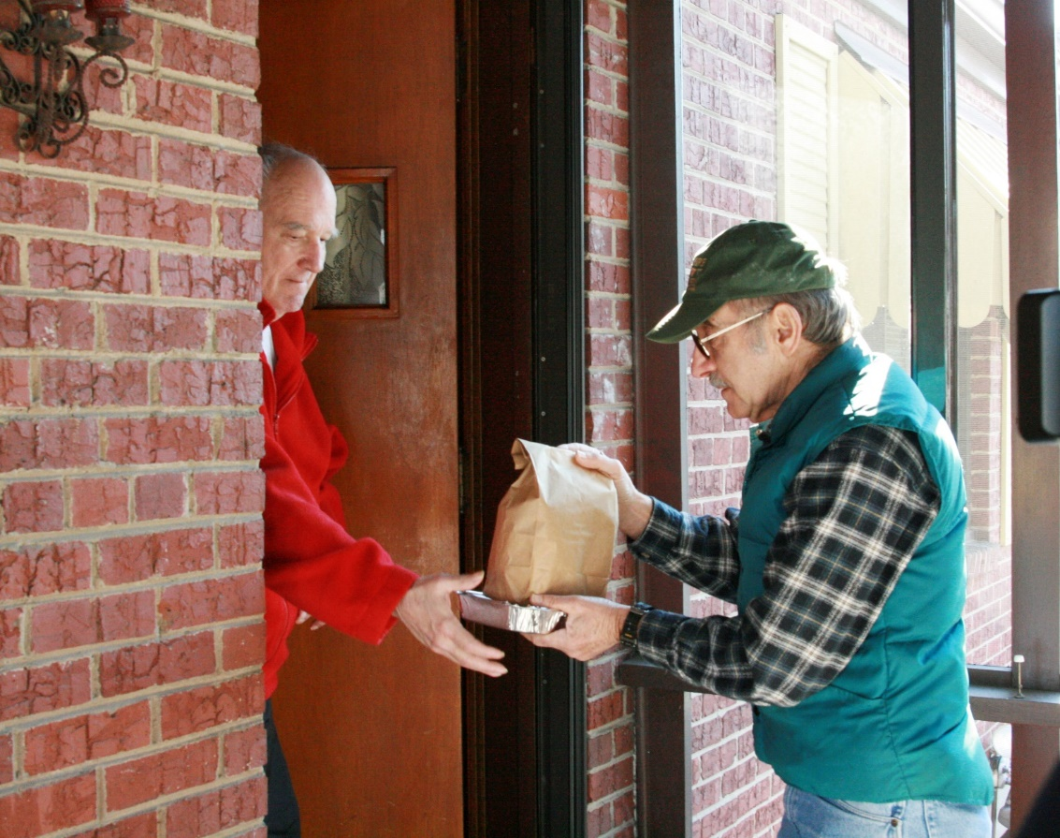
Something Magical Happens!
Notes:
Much evidence suggests benefits of home-delivered meals
Research needed
Quantify improvement in quality of life
Determine effectiveness of the daily “check in” and social contact

Slide 15
Role of Nutrition Services
Value of Nutrition for Clients with Chronic Health Conditions
Heart disease
Hypertension
Diabetes
Osteoporosis
Kidney disease
Obesity

Slide 16
Role of Nutrition Services
Other Nutrition Services
Nutrition Counseling
Nutrition Education
Nutrition Assessment

Slide 17
Role of Nutrition Services
Value Add
Wellness/Safety Check
Regular contact in the home
Trusted in the home
Client status (moved, hospital, nursing home)
Perform regular in-home assessments

Slide 18
More Than a Meal Pilot Study: All Home-delivered Clients
Improvement in feelings of anxiety, self-rated health, isolation and loneliness
Decrease in hospitalizations and falls

Slide 19
More Than a Meal Pilot Study: Daily Home-delivered Clients
Improvement in feelings of anxiety, self-rated health, isolation and loneliness
Decrease in falls and worry about staying in the home

Slide 20
More Than a Meal Pilot Study: Daily Home-delivered Living Alone Clients
Improvements in feelings of isolation and loneliness
Decreased worry about being able to remain in the home

Slide 21
More Than a Meal Pilot Study: Compare Daily to Weekly Delivery
Feel safer, helped them to eat healthier, more social contacts
Loneliness

Slide 22
Advantages for Nutrition Programs
Valued added service
Service and delivery structure in place
Trusted entity with long history of success
Linked to other community-based services
Ability to build community partnerships
Notes:
You have to mobilize quickly
The window of opportunity will not remain open indefinitely
SOMEONE will fill the need
No one should be able to mobilize faster in your community than you

Slide 23
How to Compete?
Know:
Health Reform activity in their community
    Medicare Advantage Plans
    Medicaid Managed Care initiatives
    ACOs
    Bundled Payment Initiatives
Competition
Partners
Champions

Slide 24
How To Compete?
Organizational culture change (staff qualifications, characteristics, inter-organizational operations)
Strategic business plan
Development and structure of community-based networks
Service packages (identifying, pricing and packaging services)
Marketing and sales strategies

Slide 25
How To Compete?
Communication and negotiation techniques
Addressing program capacity challenges (developing, increasing, and managing the capacity of the program to deliver services)
Continuous quality improvement (setting standards, defining and measuring outcomes, monitoring)
Risk management (identifying, accepting, and managing)
Information technology (IT) system

Slide 26

Learning as a Network

Slide 27
National Resource Center on Nutrition and Aging
Goals:
To enhance the skills, knowledge, business acumen and sustainability strategies of the nutrition and aging network.
To increase the availability of information on programs and practices showing promise of successful integration of the nutrition network in the HCBS services network.

Slide 28
National Resource Center on Nutrition and Aging
How?
Online Resources www.nutritionandaging.org
Professional development (webinars, trainings)
SUA Listserve
Year One - Single State Learning Collaborative
Follow-up with three consecutive Learning Collaboratives

Slide 29
Learning from Others
Pilot with Five Texas Nutrition Programs
Steps Nutrition Programs need to take
Time to ramp up and prepare – GAP analysis and SWOT analysis, determine who the payers are
Do an environmental scan and market research - Which service packages to provide and what technology is needed?
Price the service packages
Create a business plan
Articulate the value proposition and the ROI the services will have for the payer
Build relationships with payers

Slide 30
Learning from Others
Nutrition Learning Collaborative
Learning Collaborative (2015-2016) with eight nutrition programs – CA, CT, MN, NC, OH, TX, VA and WA
Provide targeted webinars and in-person training meetings
Offer monthly Technical Assistance calls
Ongoing development of a glossary of healthcare terms, acronyms, terms and definitions
Duration – one year
Two additional learning collaboratives to be selected (2016 & 2017)

Slide 31
Learning Collaborative 2015-2016
Deliverables for the eight programs:
To develop a Business Plan
To meet with decision makers of targeted healthcare entities – Community hospital, Hospital system, MCO, ACO etc.
To contract with or develop a formal partnership with at least one healthcare entity

Slide 32
Learning Collaborative 2015-2016
Next two Learning Collaboratives
Incorporate lessons learned from first one
Use first eight programs as mentors/coaches for second group
Leverage the learnings to Aging Nutrition Network

Slide 33


Ultimate Vision - Nutrition Programs - Part of Care Coordination Plan
HCBS
Meals
Nutrition Services
Evidence-Based Programs

Slide 34
Final Words
Know Your Market
Know Your Competition
Study Your Customer
Learn the Language
Organize and Execute

Slide 35

We have to get it right!
Notes:
The bridge is being built- Mobilize quickly.

Slide 36
Resources: www.NutritionandAging.org
Recorded NRCNA Webinars
Positioning Your HCBS Program in the Healthcare Market – 101 Webinar Series
  Part 1: Overview of Health Reform Initiatives - How this Affects
  Your Organization and Terminology 101
  Part 2: Market Analysis - Determine Health Reform Initiatives in
  Your Market Area
  Part 3: Network Collaboration - The Need for Collaboration
  Part 4: Developing a Strategy and a Business Model for Your
  Organization
  Part 5: An Assessment of the Capacity of Your HCBS Organization

Slide 37
More Resources:
Recorded NRCNA Webinars (continued)
HCBS Providers Use Quality Improvement to Demonstrate Impact
Pricing for Success: Ways to Think about Valuing your Interventions
Keeping Up with Health Care Organizations: Understanding the Value Proposition as Integrated Care Progresses
April 5, 2016 from 3:30 to 4:30 PM EDT
- Understanding the Variety of Perspectives Among Healthcare
Organization Decision Makers-How You Can Effectively Pitch to Them
To register: https://attendee.gotowebinar.com/register/6615738747875598595

Slide 38
Even More Resources:
More That a Meal Study
http://www.mealsonwheelsamerica.org/theissue/facts-resources/more-than-a-meal
NASUAD STATE Medicaid Integration Tracker
http://www.nasuad.org/initiatives/tracking-state-activity/state-medicaid-integration-tracker
The Growth of Managed Long-Term Services and Supports (MLTSS) Programs: (January 2012)
http://www.medicaid.gov/medicaid-chip-program-information/by-topics/delivery-systems/downloads/mltssp_white_paper_combined.pdf

Slide 39


Slide 40
Contact Info
Magda Hageman-Apol
magda@mealsonwheelsamerica.org
Linda Netterville
linda@mealsonwheelsamerica.org

